Slide 1
Game Development
Lecture 1

Slide 2
Welcome to Game Development

Slide 3
About the course
Instructor: Saira Aslam
3 credit hours (2,1)
2 classes x 1.5 hours each every week
i.e 3 hours a week class time
1 Lab x 3 hours each week
Practical course

Slide 4
About the instructor
Email: sairakhan@cuilahore.edu.pk

Slide 5
Marks distribution
Quizzes/Assignments - 25%
Mid Term Exam - 25%
Final Exam - 50 %

Slide 6
Pre-requisites & Expectations
Command on at least one programming language.
Object oriented programming is a must.
A good programming aptitude
Willingness to work hard

Slide 7
Expectations
Motivation and self belief
Self start on things that are not done in the class
Willingness to read tutorials, books, articles, sample codes to get things done
Positively looking forward to get things done as they happen in the course, don’t wait for exams

Slide 8
Assignments
Assignments are practical submittable coding/development/design/art work
Usually take home
Some times in form of graded practical tasks in class

Slide 9
Quizzes
All quizzes are un-announced
Quizzes are usually paper based but can be hands-on assignments
A classwork can also be counted as your quiz

Slide 10
Rules
Please do not be late in the class

Slide 11
Rules
Please take attendance seriously

Slide 12
Rules
Please do not miss the quizzes and assignments

Slide 13
Rules
Please check your emails at least once a day

Slide 14
Rules
Please check your Google Classroom at least once a day

Slide 15
Rules
Google Classroom is your ultimate companion
Please do check Classroom every day
Please change your Google/ITU password
Do not share your email password
Join Google classroom using code:
42iukno (BCS/BSE)
lg67nn4 (BCE)

Slide 16
Rules
Do not miss assignment deadlines

Slide 17
Rules
When submitting assignments, keep a copy safe with you for later use

Slide 18
Rules
Plagiarism is NOT ALLOWED
Any content caught plagiarized will get a zero ( no matter you copied or you were copied )
All those guilty of repeated plagiarism will be sent to the disciplinary committee and administration (This can get even worse )

Slide 19
Join Google classroom
Join google classroom through the given code

Slide 20
Course Content
Course is divided logically into 3 sections,
Part 1 – Game Development with Unity
Includes Unity Engine
C# as language
How to make basic 3d and 2D games
Part 2 – Game Optimization, integration and porting
Running games on platforms like PC, Android, iOS, Web etc
Multi player games
Other tools to help make a cool game
Game monetization and business
Part 3 – Your game projects --

Slide 21
Text Book
Sams – Teach Yourself Game Development with Unity in 24 Hours – Second Edition
Ben Tristem
Mike Geig
Learning React Native: Building Native Mobile Apps with JavaScript 2nd Edition by Bonnie Eisenman
React Native Cookbook - Second Edition by Dan Ward
Unity in Action
JOSEPH HOCKING

Slide 22
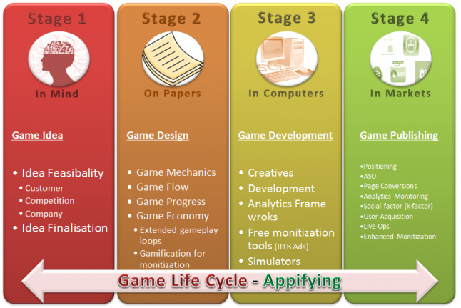
Game making process -- How
http://www.gamasutra.com/blogs/SalmanSaroya/20160223/266402/An_Introduction_to_Game_Life_Cycle.php

Slide 23
What are we doing?
Game Development mostly
Some of the 3D animations and modeling and art work/design/graphics
How to use other art work in our games
How to self publish our games etc

Slide 24
Let’s Start

Slide 25
Software Tools needed in the course
Unity
Visual Studio

Slide 26
Hardware and devices needed
A decent development PC
A Mouse, yeah, a 3Button + wheel mouse
Headphones when working with sound/music
May be a mobile device
Willingness to get hold of other devices and tools when needed

Slide 27
Your Expectation
We will learn to make cool 2D and 3D games
We will learn even to make mutiplayer games
We will learn how to setup scenes and environments
We will learn how to add music and sounds to the games
We will make amazing game-play inspired by popular games

Slide 28
Todo before 2nd class
1
2
3
Download and install Unity
https://unity.com/releases/editor/archive
Download latest version of unity Hub and then any version of 2024 for Editor
Get hold of a mouse if you don’t have one
Be sure you want to take this course, it’ll be a lot of work and a lot of fun…

Slide 29
Sign up for Unity
You need an account for unity, using your personal gmail, signup at:
https://id.unity.com/
This Login and password will be used for Unity Editor and Unity Asset store.

